Slide 1
Lecture 4
Operating Systems (COMP1562)

Slide 2

Lecture plan
Process and resource concepts
Processes and resources handling
Processes state changes cycle and queuing
Threads
Processes and threads in modern operating systems
Mariusz Pelc © 2009/2010
(with support from Dr Kevin McManus)

Slide 3
Process concept
Process is elementary active entity being managed by the operating system which uses system resources (processor time, memory, files, I/O devices) in order to run its program.
Each process consists of:
Program - defines proces behaviour
Data - data being processed and results being returned
Resources - create run-time environemnt
PCB - Processor Control Block (descriptor) storing / describing current state of the process
Mariusz Pelc © 2010/2011
(with support from Dr Kevin McManus)

Slide 4
Resources classification
Resources – is hardware or software component of the computer system required by the process to operate.
Resources classification:
Reusable (memory after process completion, CPU, file handles after process completion, swap space)
Consumable (battery power in mobile computers, available free disk space, available free memory)
Shared (more than one process may use them in the same time – for example shared memory, pipes)
Exclusive (assigned to a selected process, unavailable for others – allocated memory block)
Mariusz Pelc © 2010/2011
(with support from Dr Kevin McManus)

Slide 5
Processes and resources management operations
Operations of processes creation and closing and basic inter-process communication mechanisms
Operations of allocation/realocation/freeing of resources
Basic I/O operating
Interrupt handling procedures
Mariusz Pelc © 2010/2011
(with support from Dr Kevin McManus)

Slide 6
Data structures
Process Descriptor (Process Control Block also called Task Control Block) – is a data in the operating system kernel used by the Process Manager in order to register process state during its monitoring and supervision. It contains usually the following information:
The identifier of the process (a process identifier, or PID)
Register values for the process including, notably, the Program Counter value for the process
The address space for the process
Priority (in which higher priority process gets first preference. eg., nice value on Unix /Linux operating systems)
Process accounting information, such as when the process was last run, how much CPU time it has accumulated, etc.
Pointer to the next PCB i.e. pointer to the PCB of the next process to run
I/O Information (i.e. I/O devices allocated to this process, list of opened files, etc).
Here see how it looks in case of real (Linux) operating system.
Mariusz Pelc © 2010/2011
(with support from Dr Kevin McManus)

Slide 7
Data structures
Resource Descriptor – is storing information about availability of a specified resource. Depending on resource type (file, memory segment, etc.) the descriptor structure may be of various form. The structure is very often forced by the system architecture specification (for example, depending on logical memory structure it may relate to segments, pages, etc.).
The resource descriptor may for example contain information about:
Resource ID
Resource Type
List and number of available resources
List (queue) of processes waiting for the resource
Allocation procedure
Mariusz Pelc © 2010/2011
(with support from Dr Kevin McManus)

Slide 8
Process States
New - is created, but not running
Running - process program instructions are being processed
Waiting - process is waiting for an event (finishing I/O operation, allocation of new resources, synchronisation with other processess)
Ready - process is waiting for processor
Terminated - process has finished to run and isfreeing allocated resources
Transition between some of the above states is dependant on the system state and is managed by schedulers.
Mariusz Pelc © 2010/2011
(with support from Dr Kevin McManus)

Slide 9
Scheduling
Scheduling - is the process of deciding how to commit resources between a variety of possible/running tasks (processes). Scheduling is supervised by a special system process called scheduler.
There are three types of schedulers:
Short Term Scheduler (SSch) is responsible for allocation of processor to ready processes
Medium Term Scheduler (MSch) is responsible for processes exchange between main and external mamory (i.e. Hard drive)
Long Term Scheduler (LSch) – responsible for loading new programs into memory, control of number of tasks in the system as well as balancing resource usage by tasks selection
Mariusz Pelc © 2010/2011
(with support from Dr Kevin McManus)

Slide 10
Process State Change Cycle
NEW
TERMINATED
LSch - admit
SSch –interrupt running (timeout)
READY
RUNNING
MSch – exchange
MSch - exchange
SSch – dispatch
READY/
SUSPENDED
WAITING
READY/
ACTIVE
Fig.1. Process state change cycle
Mariusz Pelc © 2010/2011
(with support from Dr Kevin McManus)

Slide 11
Reasons of process termination
Normal completion
Time limit exceeded
Memory unavailable
Memory bounds violation
Protection error
example write to read-only file
Arithmetic error
Time overrun
process waited too long for an event
Manual intervention
user, administrator
I/O failure
Invalid instruction
e.g. processor tries to execute data
Operating system intervention
such as when deadlock occurs
Parent terminates so child processes terminate
Parent kills the child
Mariusz Pelc © 2010/2011
(with support from Dr Kevin McManus)

Slide 12
Reasons of process suspension
Swapping - the OS needs to release sufficient main memory to bring in a process that is ready to execute
Other OS reason - a process causing system problem may be suspended; a good reason to suspend processes is when the system goes to sleep mode
User request - a user may wish to suspend a process for various purposes (for example for debugging), he may also send a specified signal to a process (SIGTSTP signal in POSIX)
Timing - a process may be executed periodically
Parent process request - a parent process may suspend a descendent for synchronisation reasons
Mariusz Pelc © 2010/2011
(with support from Dr Kevin McManus)

Slide 13
Process State Change Cycle
Processor
Ready queue
I/O
I/O queue
Request I/O operation
Time quant elapsed
Signal
Synchronisation
Waiting queue
Fig.2. Queues in the task scheduling
Mariusz Pelc © 2010/2011
(with support from Dr Kevin McManus)

Slide 14
Context switching
When a process is leaving running state, the processor is available for another process and context switching takes place. This consists of two steps:
Saving state (context save) of the process leaving processor,
Loading state (context load) of the process to which processor was assigned.
Save context in PCB_1
Process 1
Idle
Restore context from PCB_2
Process 2
Idle
Idle
Process 3
Idle
Idle
Fig.3. Context switching
Mariusz Pelc © 2010/2011
(with support from Dr Kevin McManus)

Slide 15
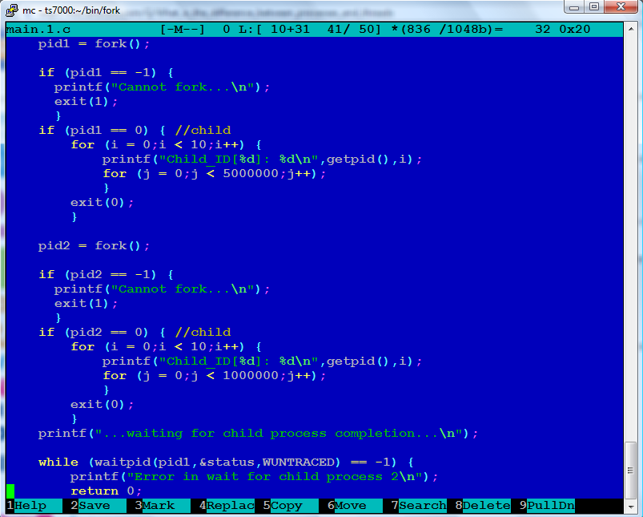
Processes in Linux – context switching
Mariusz Pelc © 2010/2011
(with support from Dr Kevin McManus)

Slide 16
Processes in Linux – context switching - trace
root@ts7000:fork# ./process_demo
...waiting for child process completion...
Child_ID[1848]: 0
Child_ID[1849]: 0
Child_ID[1849]: 1
Child_ID[1849]: 2
Child_ID[1849]: 3
Child_ID[1849]: 4
Child_ID[1848]: 1
Child_ID[1849]: 5
Child_ID[1849]: 6
Child_ID[1849]: 7
Child_ID[1849]: 8
Child_ID[1849]: 9
Child_ID[1848]: 2
Child_ID[1848]: 3
Child_ID[1848]: 4
Child_ID[1848]: 5
Child_ID[1848]: 6
Child_ID[1848]: 7
Child_ID[1848]: 8
Child_ID[1848]: 9
...exiting parent process...
root@ts7000:fork#
Mariusz Pelc © 2010/2011
(with support from Dr Kevin McManus)

Slide 17
Processes handling in Ix and Windows
Process creation:
POSIX: fork
Windows: CreateProcess
Removing procesu:
POSIX: exit, abort, kill
Windows: ExitProcess, TerminateProcess.
Suspend and activate process.
Change priority of a process:
POSIX: nice (setpriority)
Windows: SetPriorityClass
Waiting for process completion:
POSIX: wait, waitpid
Windows: lack of support, the use of synchronisation methods is needed
Mariusz Pelc © 2010/2011
(with support from Dr Kevin McManus)

Slide 18
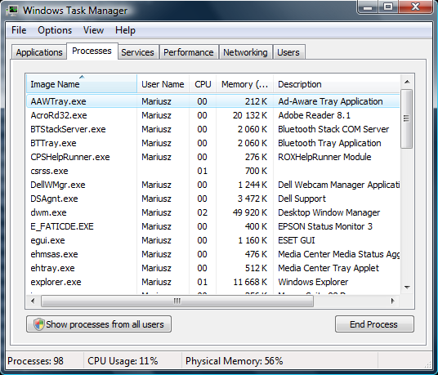
Processes in Windows
Mariusz Pelc © 2010/2011
(with support from Dr Kevin McManus)

Slide 19
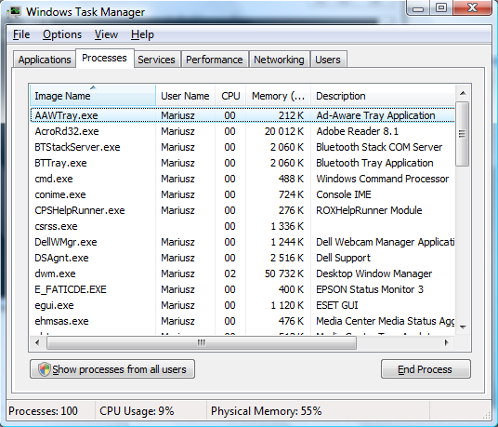
Processes in Windows
Mariusz Pelc © 2010/2011
(with support from Dr Kevin McManus)

Slide 20
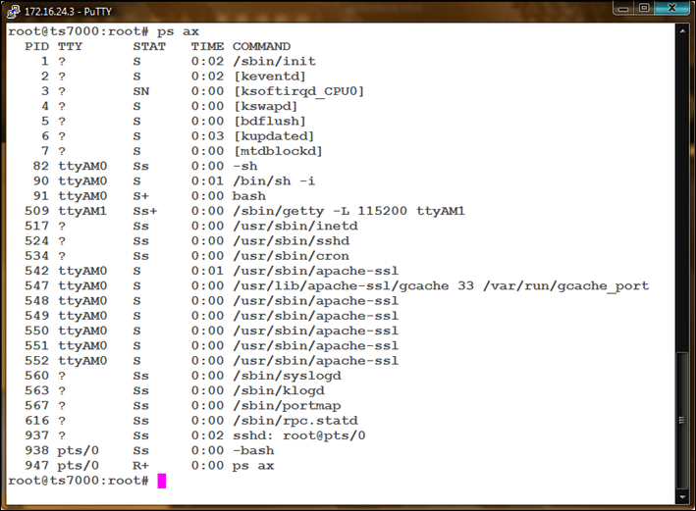
Processes in Linux – processes list
Process status:
D – uninterruptible
Sleep (usually I/O)
R – runnable (or in
queue)
S – sleeping
T – traced or
stopped
X – dead
Z – a defunct
(zombie process)
Mariusz Pelc © 2010/2011
(with support from Dr Kevin McManus)

Slide 21
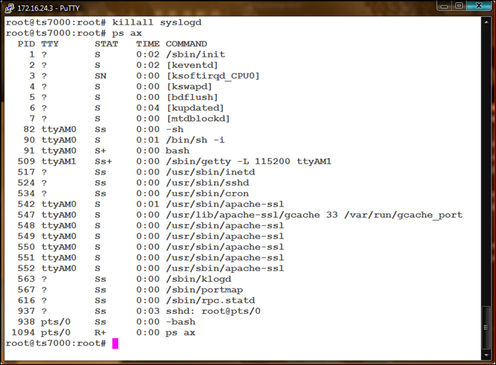
Processes in Linux – killing a process .
Process status:
D – uninterruptible
Sleep (usually I/O)
R – runnable (or in
queue)
S – sleeping
T – traced or
stopped
X – dead
Z – a defunct
(zombie process)
Mariusz Pelc © 2010/2011
(with support from Dr Kevin McManus)

Slide 22
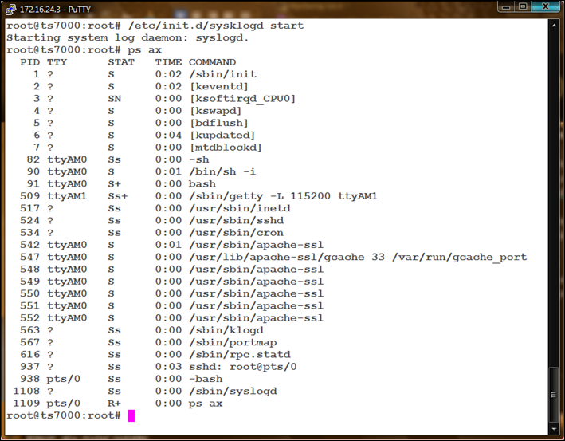
Processes in Linux – starting a process
Process status:
D – uninterruptible
Sleep (usually I/O)
R – runnable (or in
queue)
S – sleeping
T – traced or
stopped
X – dead
Z – a defunct
(zombie process)
Mariusz Pelc © 2010/2011
(with support from Dr Kevin McManus)

Slide 23
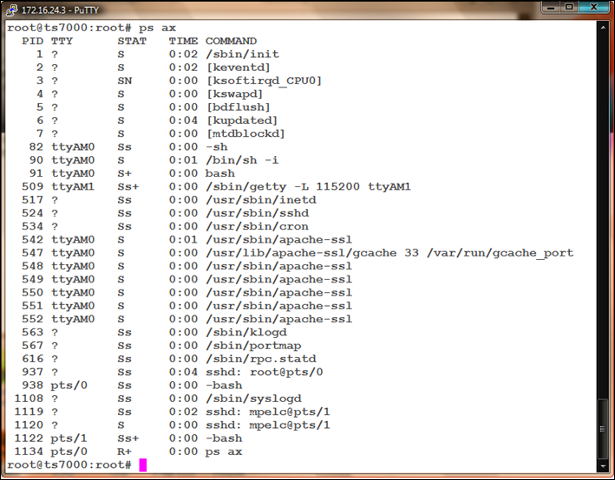
Processes in Linux – starting a process (automatic start)
Process status:
D – uninterruptible
Sleep (usually I/O)
R – runnable (or in
queue)
S – sleeping
T – traced or
stopped
X – dead
Z – a defunct
(zombie process)
Mariusz Pelc © 2010/2011
(with support from Dr Kevin McManus)

Slide 24
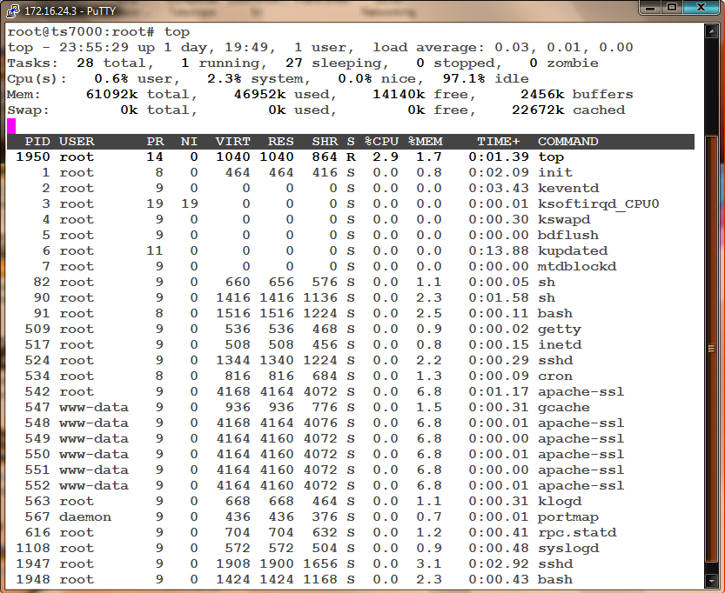
Processes in Linux – another tools for system process monitoring
Mariusz Pelc © 2010/2011
(with support from Dr Kevin McManus)

Slide 25
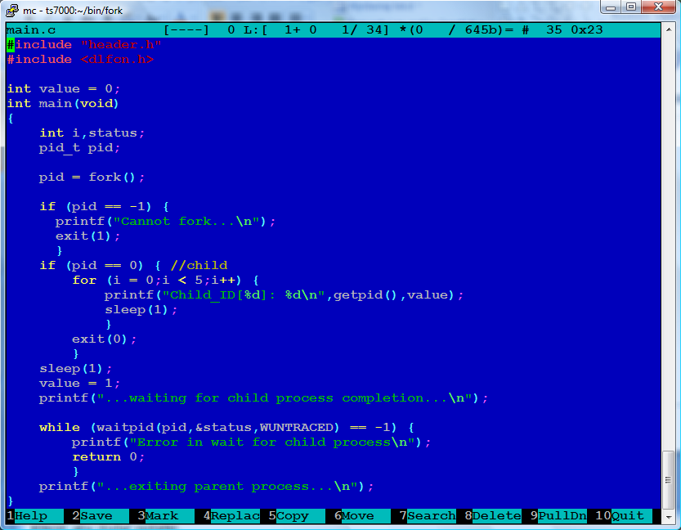
Processes handling in Linux – program creating a process
Mariusz Pelc © 2010/2011
(with support from Dr Kevin McManus)

Slide 26
Processes handling Linux – program creating a process - trace
root@ts7000:fork# ./process_demo
Child_ID[1788]: 0
...waiting for child process completion...
Child_ID[1788]: 0
Child_ID[1788]: 0
Child_ID[1788]: 0
Child_ID[1788]: 0
...exiting parent process...
root@ts7000:fork#
Mariusz Pelc © 2010/2011
(with support from Dr Kevin McManus)

Slide 27
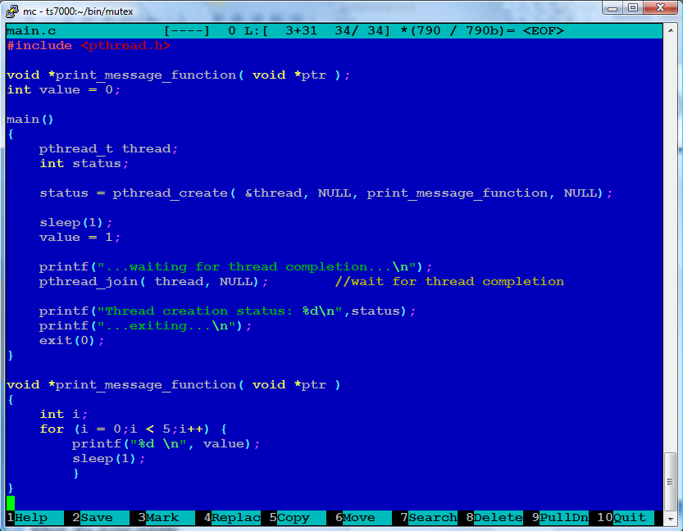
Threads Linux – program creating a thread
Mariusz Pelc © 2010/2011
(with support from Dr Kevin McManus)

Slide 28
Threads Linux – program creating a thread - log
root@ts7000:mutex# ./thread_demo
0
...waiting for thread completion...
1
1
1
1
Thread creation status: 0
...exiting...
root@ts7000:mutex#
Mariusz Pelc © 2010/2011
(with support from Dr Kevin McManus)

Slide 29
Threads vs. Processes – key difference
root@ts7000:mutex# ./thread_demo
0
...waiting for thread completion...
1
1
1
1
Thread creation status: 0
...exiting...
root@ts7000:mutex#
Mariusz Pelc © 2010/2011
(with support from Dr Kevin McManus)

Slide 30
Threads Linux – program creating a thread - log
Threads:
A thread has no data segment or heap
A thread cannot live on its own, it must live within a process
There can be more than one thread in a process, the first thread calls main & has the process’s stack
Inexpensive creation
Inexpensive context switching
If a thread dies, its stack is reclaimed
Processes:
A process has code/data/heap & other segments
There must be at least one thread in a process
Threads within a process share code/data/heap, share I/O, but each has its own stack & registers
Expensive creation
Expensive context switching
If a process dies, its resources are reclaimed & all threads die
Mariusz Pelc © 2010/2011
(with support from Dr Kevin McManus)

Slide 31
Operating system control structures
Processes and resource management requires some dedicated data structures, where the crucial information about processes and resource state is being stored (and updated accordingly to situation). These include tables constructed for each entity that the operating system manages:
Memory
I/O
File
process
Mariusz Pelc © 2010/2011
(with support from Dr Kevin McManus)

Slide 32
Memory tables
Allocation of main memory to processes
Allocation of secondary memory to processes
Protection attributes for access to shared memory regions
Information needed to manage virtual memory
Mariusz Pelc © 2009/2010
(with support from Dr Kevin McManus)

Slide 33
I/O tables
I/O device is available or assigned
Status of I/O operation
Location in main memory being used as the source or destination of the I/O transfer
Mariusz Pelc © 2010/2011
(with support from Dr Kevin McManus)

Slide 34
File tables
Existence of files
Location on secondary memory
Current Status
Attributes
This information may be maintained by a file-management system
Mariusz Pelc © 2010/2011
(with support from Dr Kevin McManus)

Slide 35
Process table
Where process is located
Attributes necessary for its management
Process ID
Process state
Location in memory
User ID
Mariusz Pelc © 2010/2011
(with support from Dr Kevin McManus)

